Slide 1

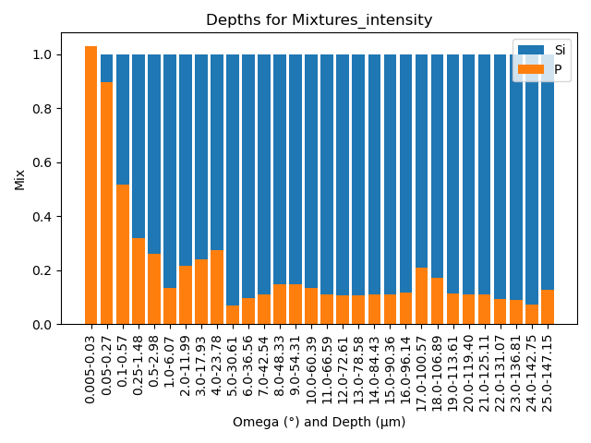
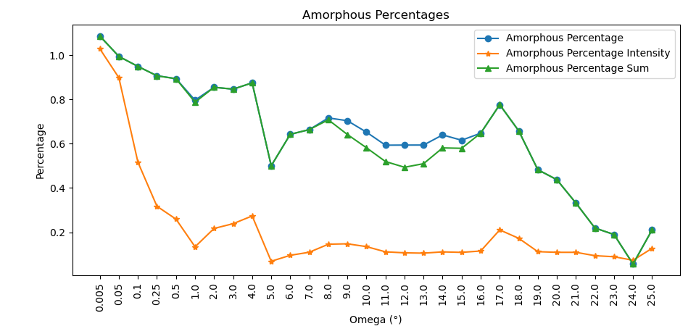
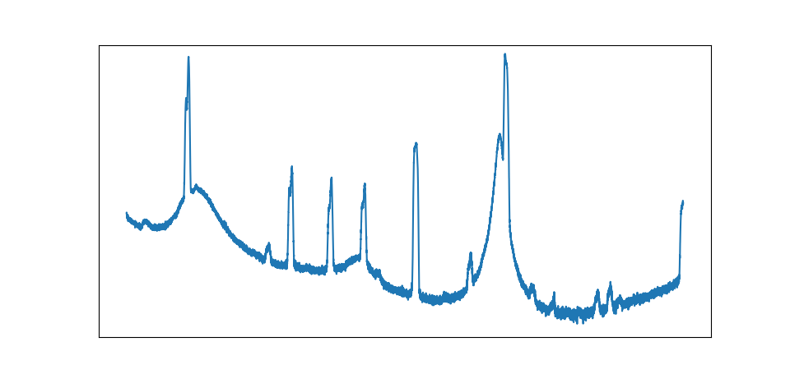
Deeper Insights:
Unveiling Dopant Profiles with GIXRD
Mark Smith
Advisor:
David Oliphant
Abstract:
Background:
In this work, grazing incidence X-ray diffraction (GIXRD) is utilized to investigate the depth profile of dopants in silicon. By systematically varying the X-ray incidence angle, one can precisely control the depth penetrated into doped silicon samples. This approach enables a non-destructive analysis of how dopant concentration evolves with depth. The findings provide crucial insights into the distribution and behavior of dopants, which is essential for optimizing semiconductor device performance and fabrication processes.
X-Ray crystallography is used to determine composition of selected materials. This is done by emitting x-rays at the sample, and seeing how the beam interferes after it has interacted with sample. This produces a characteristic pattern (bottom middle image) that is then used for analysis. The author has used three methods to determine relative percentages of phosphorus diffused into silicon.
Methods:
Take the ratio of the peak heights
Fit the peaks to a Gaussian, and find the integrated area
Perform a summation to find the numerical integral
Diagram of XRD Using GIXRD
Conclusion:
GIXRD allows for a non-destructive way to probe into a material allowing for subsurface insights. This technique has allowed for depth, and composition estimates. Further work would be comparing these results to a known sample.
Technique:
GIXRD holds the incident angle fixed while moving the detector. Subsequent scans are done with different incident angles to probe different depths. Then by looking at the different peak heights, and breadths, one can make conclusions about the relative percentages of the material above it.
XRD Raw Data
References:
Pandey, A., Dalal, S., Dutta, S. et al. Structural characterization of polycrystalline thin films by X-ray diffraction techniques. J Mater Sci: Mater Electron 32, 1341–1368 (2021). https://doi.org/10.1007/s10854-020-04998-w
AXT PTY LTD. (2021, September 24). \emph{X-Ray Diffraction for Materials Science - AXT Pty Ltd.} https://www.axt.com.au/x-ray-diffraction-for-materials-science/

Slide 2
For XRD Manual

